Slide 1


Cornwall Opportunities Lesson Plan
Overview for Teachers
Over three sessions, pupils will be introduced to Cornwall’s biggest industries with a few activities.
Session | Activity
Introduction to Cornwall’s top industries | Pupils get an introduction into Cornwall’s biggest industries Pupils get a quick breakdown of the Cornish labour market through interesting facts and stats. A short quiz to solidify what they’ve learnt.
2. Industry examples/case studies | Remind pupils of Part 1 with more interesting labour market stats Go in-depth into two example industries on the Cornwall Opportunities portal. Share real stories from people working in those industries through videos and a case study. Activity: Children will be asked to pick 3 dream jobs using the Job Category section on the Cornwall Opportunities website. Explore the job’s prospects.
3. Group activity | Pupils will be asked to think about other industries that might be appealing to them. Put pupils into small groups and give each group an industry to work in. Each pupil must find a job role and uncover the career path to get that job (e.g. would they go to university and what would they need to study) *Optional - Groups to present and show their workings as to how they would get their nominated job.

Slide 2
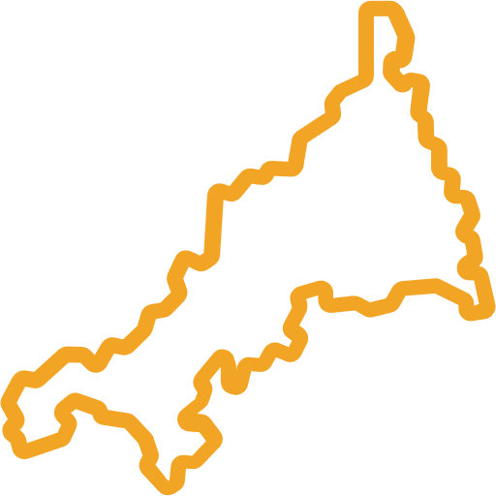

Session 1
Unlocking Cornwall’s Industries

Slide 3



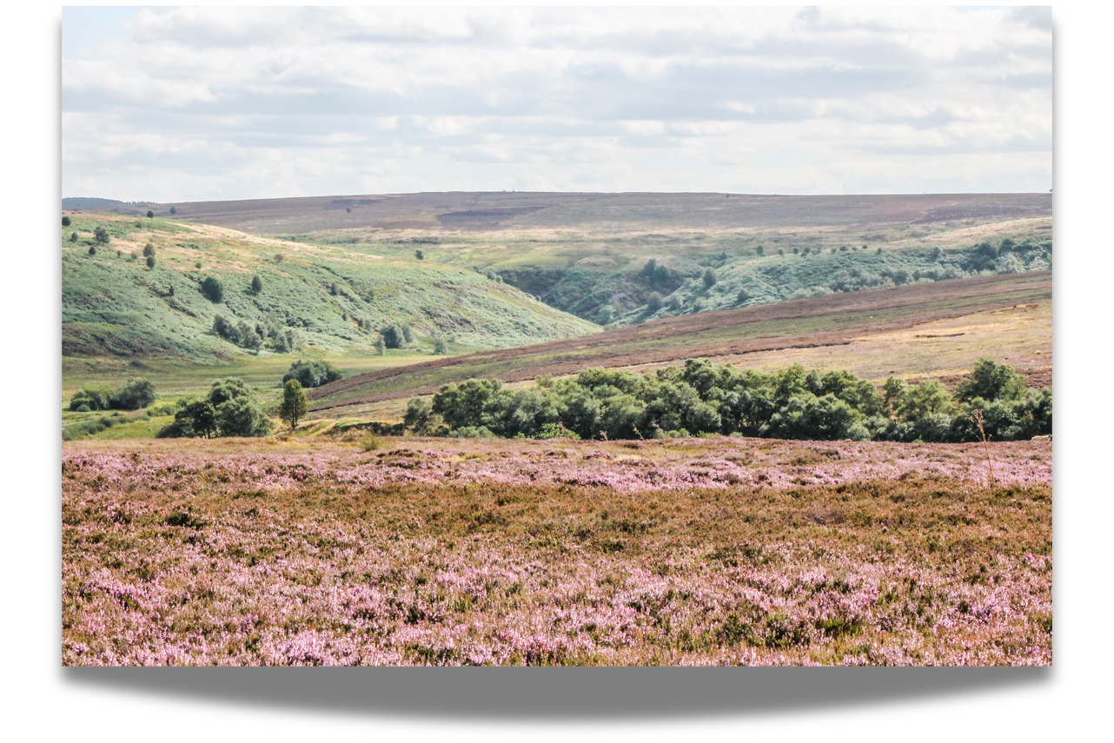
Cornwall
Lots of people know Cornwall for the beach, pretty landscapes and pasties. However, if you live here, you probably see it quite differently! This county is home to some important industries that bring money to the area and help local people to make a living.
Some of you may already know about these industries or know somebody that works in them. Two examples include fishing or hospitality (working in a hotel or a café).
Let’s check out the rest...

Slide 4












Cornwall’s Top Industries
Data and Space
Clean Energy
Construction
Creative
Engineering and Manufacturing
Digital
Health and Social Care
Land-Based
Marine
Visitor Economy
There are around 78 space-related Further Education courses available at Cornwall College and Truro & Penwith College!

Slide 5





Statistics
Let’s take a look at what type of jobs people in Cornwall have compared to the rest of England.
The Visitor Economy makes up 15% of the Cornish economy, Health and Social Care makes up 14% and Manufacturing sectors make up 11%.
More people in Cornwall work in Health Services and Agriculture, Forestry and Fishing than the rest of England while less work in sectors such as Information and Communication and Finance and Insurance compared to the rest of England.
Notes:
Data can be seen here: https://www.economyhub.cornwall.gov.uk/economy-and-employment/#/view-report/9e93e3faae4c449084e459fcd86e88d0/___iaFirstFeature/G3

Slide 6


More people in Cornwall work in skilled trades occupations (plumbers, electricians, mechanics) than the rest of England.
There are less people in Cornwall working in professional occupations (lawyers, accountants, architects) than in England.

Slide 7

More women in Cornwall work in admin, secretarial and professional occupations.
There is almost an equal amount of men (10.6%) and women (9.5%) in teaching jobs.
More men in Cornwall work in skilled trades occupations.

Slide 8
Quiz Time
Which of these is NOT one of Cornwall’s top industries?
A
Data & Space
B
Construction
C
Creative
D
Finance and Insurance

Slide 9

Quiz Time
Which of these is NOT one of Cornwall’s top industries?
A
Data & Space
B
Construction
C
Creative
Finance and Insurance

Slide 10
Quiz Time
Out of these three, which brings in the highest percentage to the Cornish economy?
Engineering & Manufacturing
A
Visitor Economy
B
Health and Social Care
C

Slide 11
Quiz Time
Out of these three, which brings in the highest percentage to the Cornish economy?
A
Engineering & Manufacturing
Visitor Economy
C
Health and Social Care

Slide 12
Quiz Time
True or False: There are more women than men in teaching jobs in Cornwall
A
True
B
False

Slide 13
Quiz Time
True or False: There are more women than men in teaching jobs in Cornwall
A
True
False

Slide 14

Session 2
Diving into Cornwall’s industries

Slide 15


Statistics
Let’s recap with some more facts about Cornwall and its job market.
Full time workers aged 16 - 64
66%
Part time workers aged 16 - 64
34%

Slide 16




Hours worked weekly in Cornwall
Percentage of self employed people
Under 10 hours
5%
10 - 34 hours
34%
9.8%
9.6%
8.1%
35-44 hours
44%
Cornwall
South West
England
45 hours or more
17%

Slide 17

Let’s explore some of Cornwall’s biggest industries with the Cornwall Opportunities portal!
Notes:
https://www.cornwall-opportunities.co.uk/ - link will take you to the homepage. The video on the next slide will explain how to use the site.

Slide 18


Notes:
Click either the play button or the video will take you here: https://www.youtube.com/watch?v=N5wojeh8-HE - an explainer video of how the website works.

Slide 19

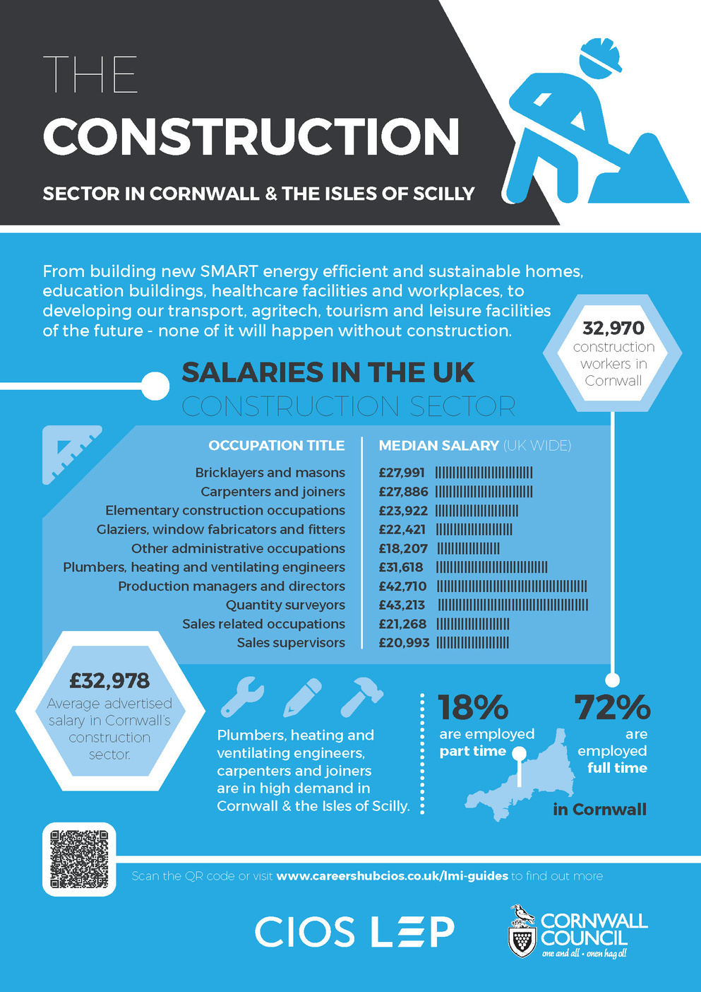

Construction
Notes:
The construction button will take you to the Cornwall Opportunities website and a specific page on Construction. At the bottom of the page, you will find 'Construction Labour Market information' and 'construction poster' available to download as a PDF for classroom display or handouts.

Slide 20
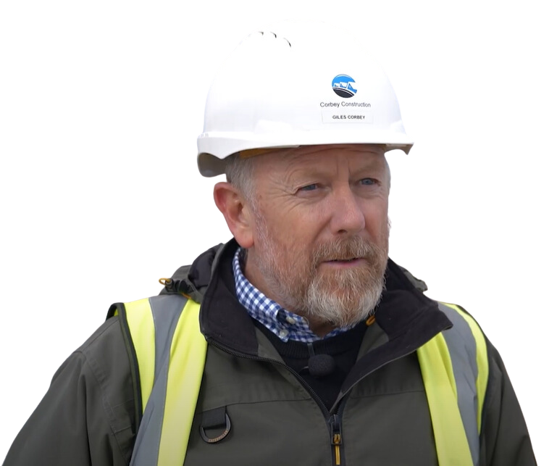
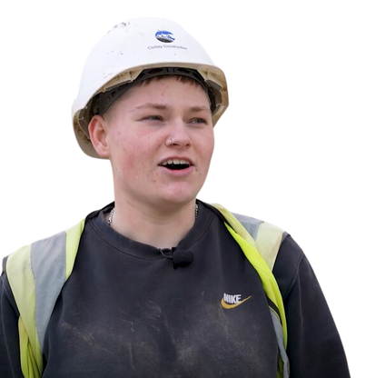

Meet Giles
Managing Director of Corbey Construction
Giles started out as an apprentice almost 40 years ago and now takes on about five apprentices every year. He has built up most of his workforce from people that he has trained up or that have been trained up by his company.
Tegan, Bricklaying Apprentice at Corbey Construction
"I always wanted to be in a trade, but with the stigma around me being a woman, it kind of set me back a bit. I started later in life, but it's the best thing I've ever done."
Hear their stories
Notes:
Pressing the 'hear their stories' button will take you to a video case study for Corbey Construction featuring Giles Corbey and apprentices.

Slide 21

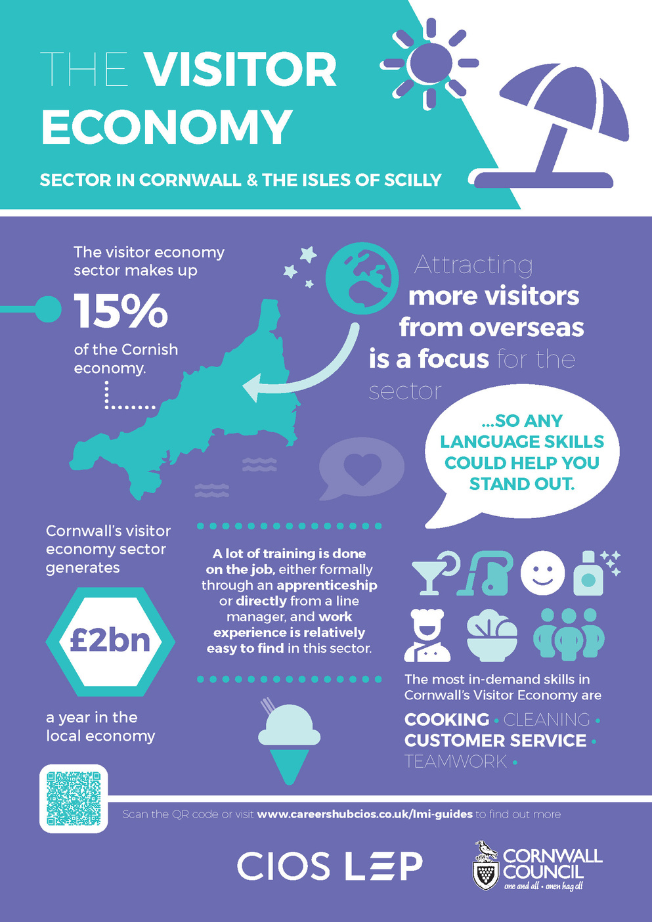
Visitor Economy
Notes:
The 'Visitor Economy' button will take you to a specific page on the Cornwall Opportunities website highlighting the Visitor Economy sector. As with construction, you can scroll down to the bottom of the page for useful infographics and posters.

Slide 22



Franci, Food & Beverage Apprentice with Philema Hospitality Management
“I think an apprenticeship, if you’re willing to work hard, it’s really really rewarding...I feel like I learn something new every day.”
Hear her story
Meet Jed
Learning Development Manager
at The Eden Project
"Having done apprenticeships now for about eight years, we're seeing those apprentices go on to lots of different things within the organisation."
Apprenticeships at Eden
Notes:
'Hear her story' button will take you to a video case study for Philema Hospitality Management featuring Franci and her colleagues' stories.
The 'Apprenticeships at Eden' button will take you to a video case study about the work Eden do with apprentices etc.

Slide 23
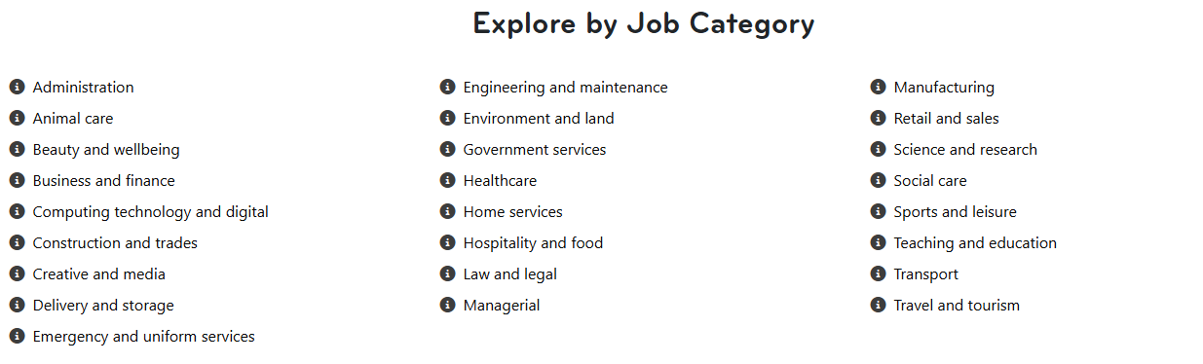
Activity Time
Choose an industry you would like to work in and then pick three of your favourite jobs.
Which industry would you like to work in?
Pick a job category from one of the below:
Now, explore each job category and pick out 3 of your dream jobs on the Cornwall Opportunities website. Check out all the helpful information about the type of money you could earn, what qualifications you need and more...
Notes:
This section can be found here: https://www.cornwall-opportunities.co.uk/careers-directory/ - each industry is clickable to explore.

Slide 24

Session 3
Working on career paths

Slide 25










Which other industries appeal to you?
Data and Space
Clean Energy
Construction
Creative
Engineering and Manufacturing
Digital
Health and Social Care
Land-Based
Marine
Visitor Economy

Slide 26
Time to get into groups!
  Each group will be given an industry to work in.
  Each person must pick a job from that industry and use the Cornwall Opportunities website to uncover a career path.
  For bonus points, try and find specific courses or apprenticeships available via the Search tool.
  If there is enough time at the end, show the class the career path you would need to take for your job!
Notes:
Put students in pairs or groups to be given a specific industry. Each group can use the Career Directory to choose a job from within that sector. Students can see what they could study, then find out where they could study etc. The search tool can be found here: https://www.cornwall-opportunities.co.uk/opportunities/all-opportunities/

